Slide 1
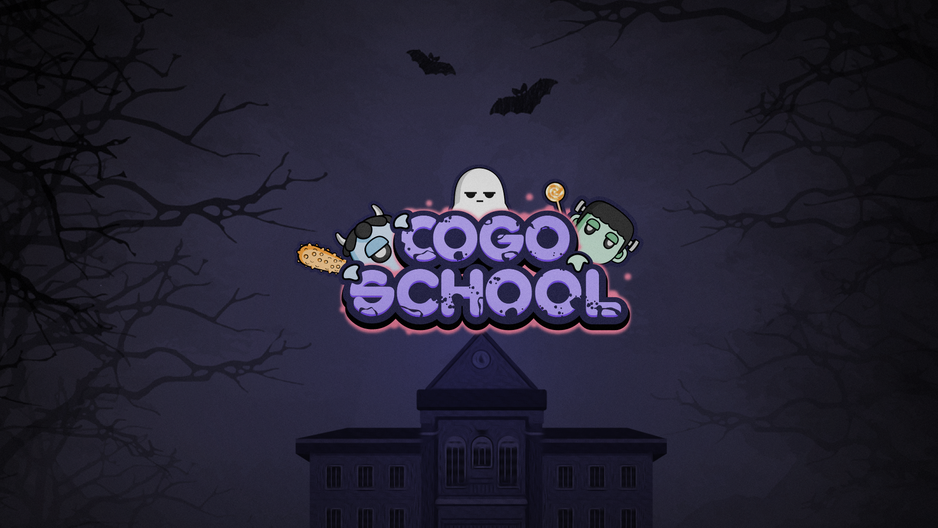

Slide 2
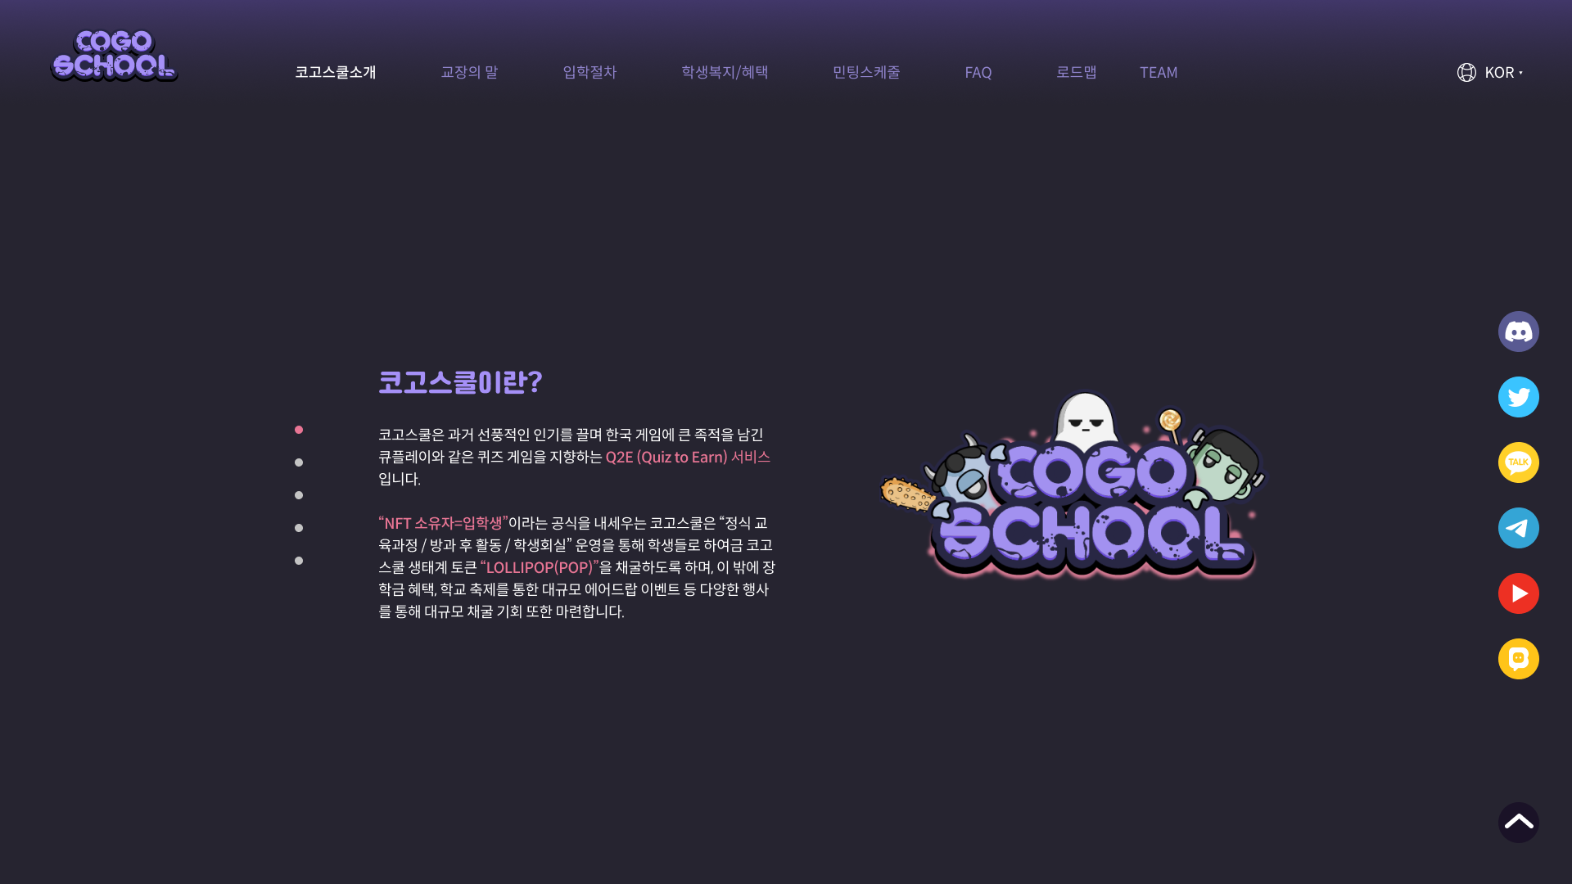
COGOSCHOOL IS
PRINCIPAL’S WORD
ADMISSION PROCEDURE
STUDENT’S BENEFIT
MINTING SCHEDULE
FAQ
ROADMAP
TEAM
What is CogoSchool?
Cogoschool aims to be a Q2E(Quiz to Earn) service, just like QPlay which was one phenomenal in Korean E-game history, but with more edge in it!
“NFT Holder = Students” is the main idea of Cogoschool. Cogoschool’s activities are categorized into ‘regular curriculum / afterschool activities / student council’ each with Cogoschool ecosystem token “LOLLIPOP(POP) earning system. Also Cogoschool will be providing other mining opportunities such as ‘scholarship’ and ‘cogoschool festival’ carried with big airdrop events.

Slide 3
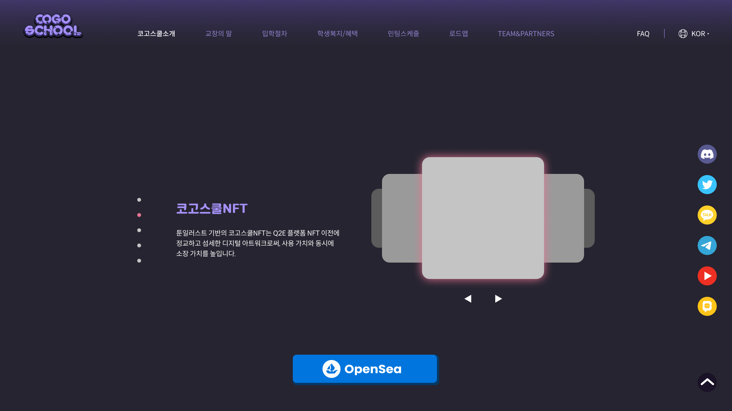
Cogoschool NFT
Toon Illustrated Cogoschool NFT is not an ordinary NFT but also a sophisticated and delicate digital artwork providing both the value of utility and collection.

Slide 4
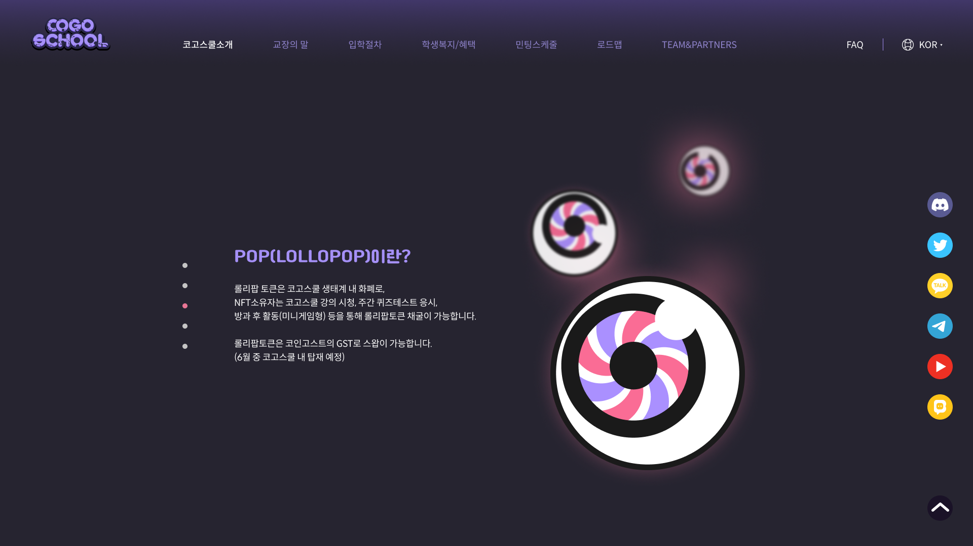
What is LOLLIPOP?
Lollipop tokens, as the currency in the Cogoschool ecosystem, NFT holders can gain POP by watching Cogoschool lectures, taking weekly pop-quiz, and after-school activities (mini-game type). Lollipop Token will be able to be swapped with Coinghost's GST. (To be activated in June)

Slide 5
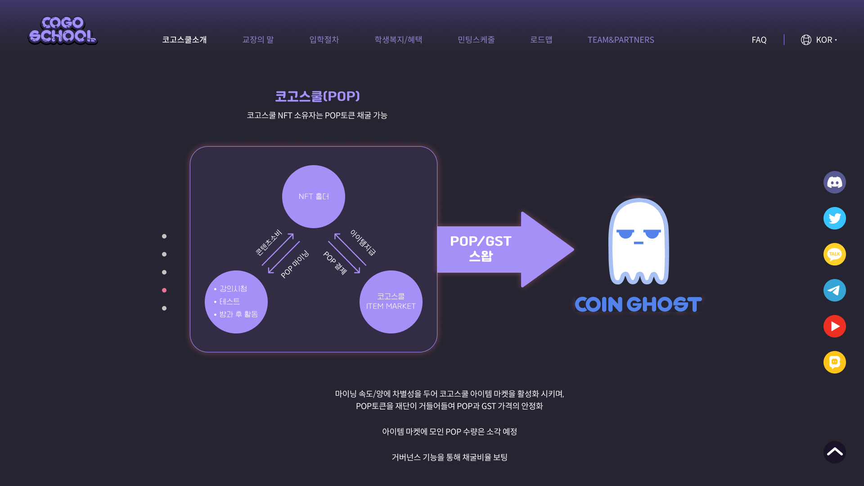
NFT HOLDER
Consuming Contents
Mining POP
Get Item
Pay POP
SWAP
COGOSCHOOL
SERVICE
MARKET
Different mining speed/amount to activate the Cogoschool item market, and the foundation collects POP tokens to stabilize POP and GST prices.
POP collected at the item market to be burnt.
Mining rate will be decided upon the governance.

Slide 6
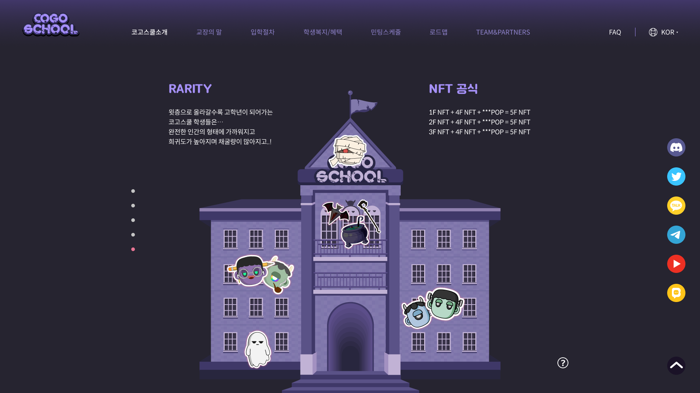
NFT FOLMULA
Cogoschool students who advance to upper class… will be a step a closer to human being will be more rare will enjoy more mining

Slide 7
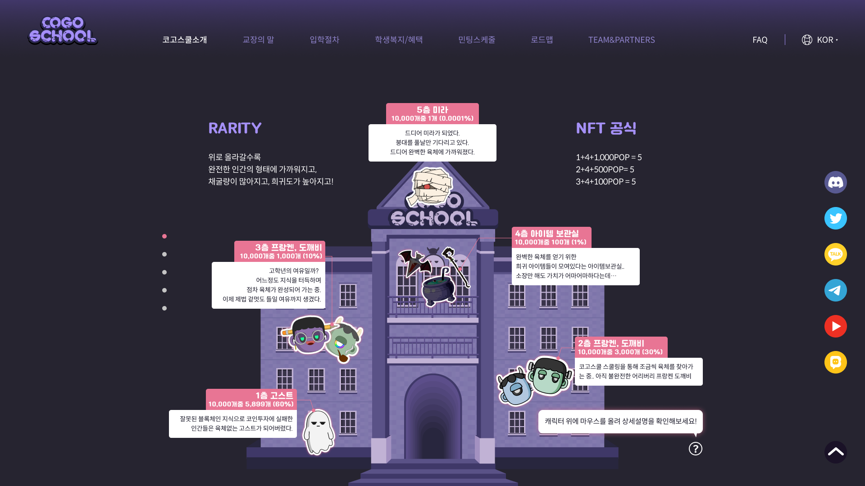
5F Mummy
Finally, I am a mummy!
Have waited long time get rid of the bandage!
And now I am complete!
4F Item Storage
Storage room full of rare items which will perfection oneself… The value of ownership is enormous!
3F FRANKEN, GOBLIN
You may call it the luxury of the upper class… Perfecting oneself by gaining more knowledge Now have the luxury to go and do some FLEXING!
2F FRANKEN, GOBLIN
In search of the perfect body through Cogoschool schooling.. Frankenstein, yet to be perfect
1F GHOST
Those who failed to make the right investment… became a being without soul…
Mouse Over

Slide 8
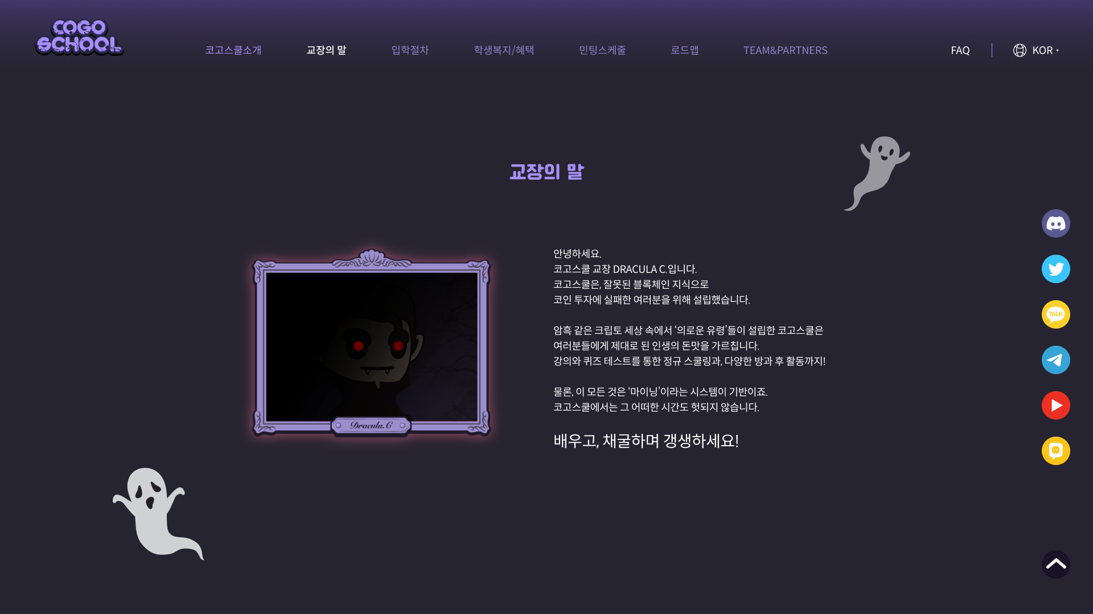
Pricipal’s Words
Greetings all, This is the pricial of Cogoschool speaking. My name is Dracula C. and I welcome all of you who ‘might’ have made the wrong choice resulting in crypto investment failure. The whole purpose of Cogoschool is to stop people from failing in investment. In the darkest world of crypto, we, the righteous ghost, would like to enlighten you and guide you to the real taste of success. Save yourselves by taking parts in lectures and quiz, regular curriculum and variety of after school activities. All of these are based on Cogoschool’s mining system. Every actions counts! No more wasting time! Learn! Mine!
And reincarnate, let’s be human again!

Slide 9
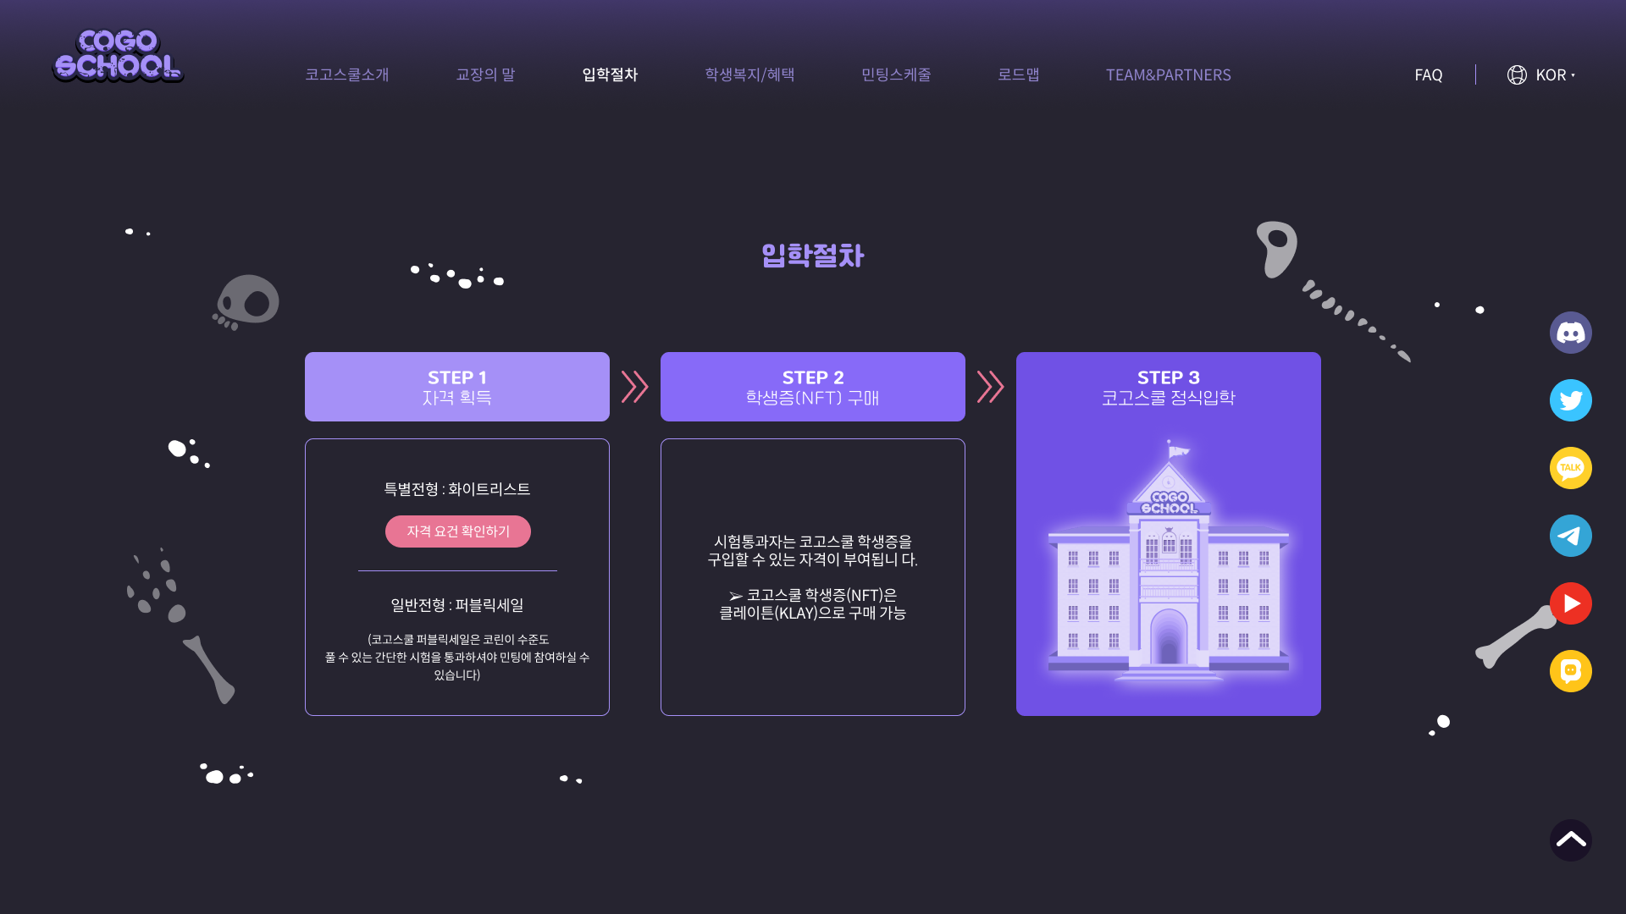
Cogoschool admission
STEP 1
Cogoschool admission
Special Enrollment Method : Whitelist
(Check requirements)
Regular Enrollment Method : Public Sale (You need to pass a simple & easy pop quiz in order to take part in the public sale)
STEP 2
Get your school ID(NFT)
Those who passes the quiz are qualified to get ‘cogoschool student ID)
STEP 3
Cogoschool admission

Slide 10
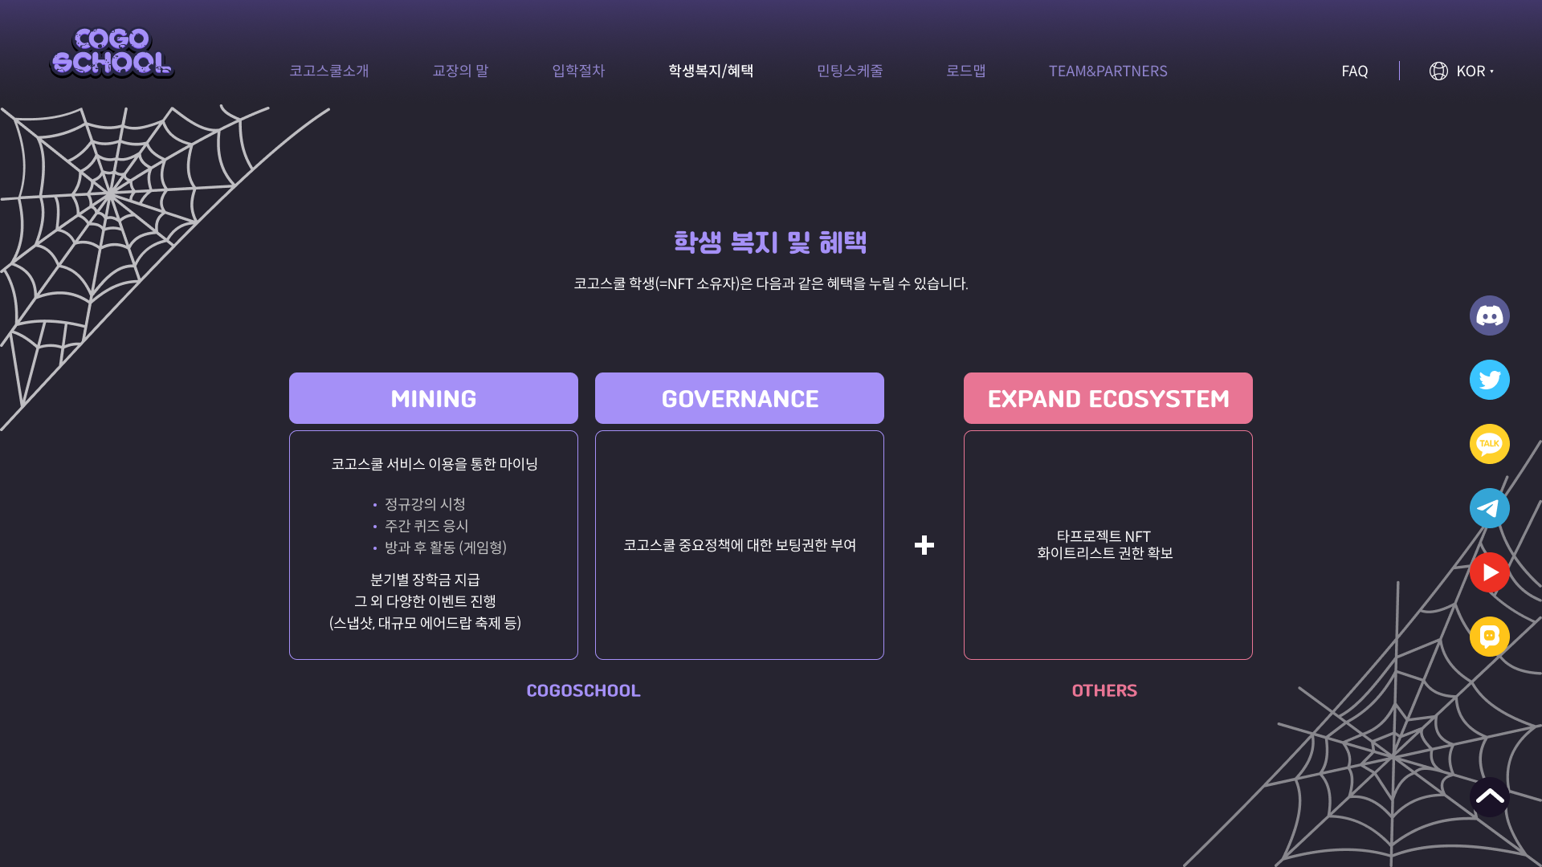
Student’s Benefits
Cogoschool Students(NFT holder) are eligible to the following benefits
Obtain Other Project NFT Whitelist Privileges
Mining through Cogoschool features - regular lecture / weekly pop quiz / afterschool activities
Granting Boating Authority to Important Policies of Cogoschool.

Slide 11
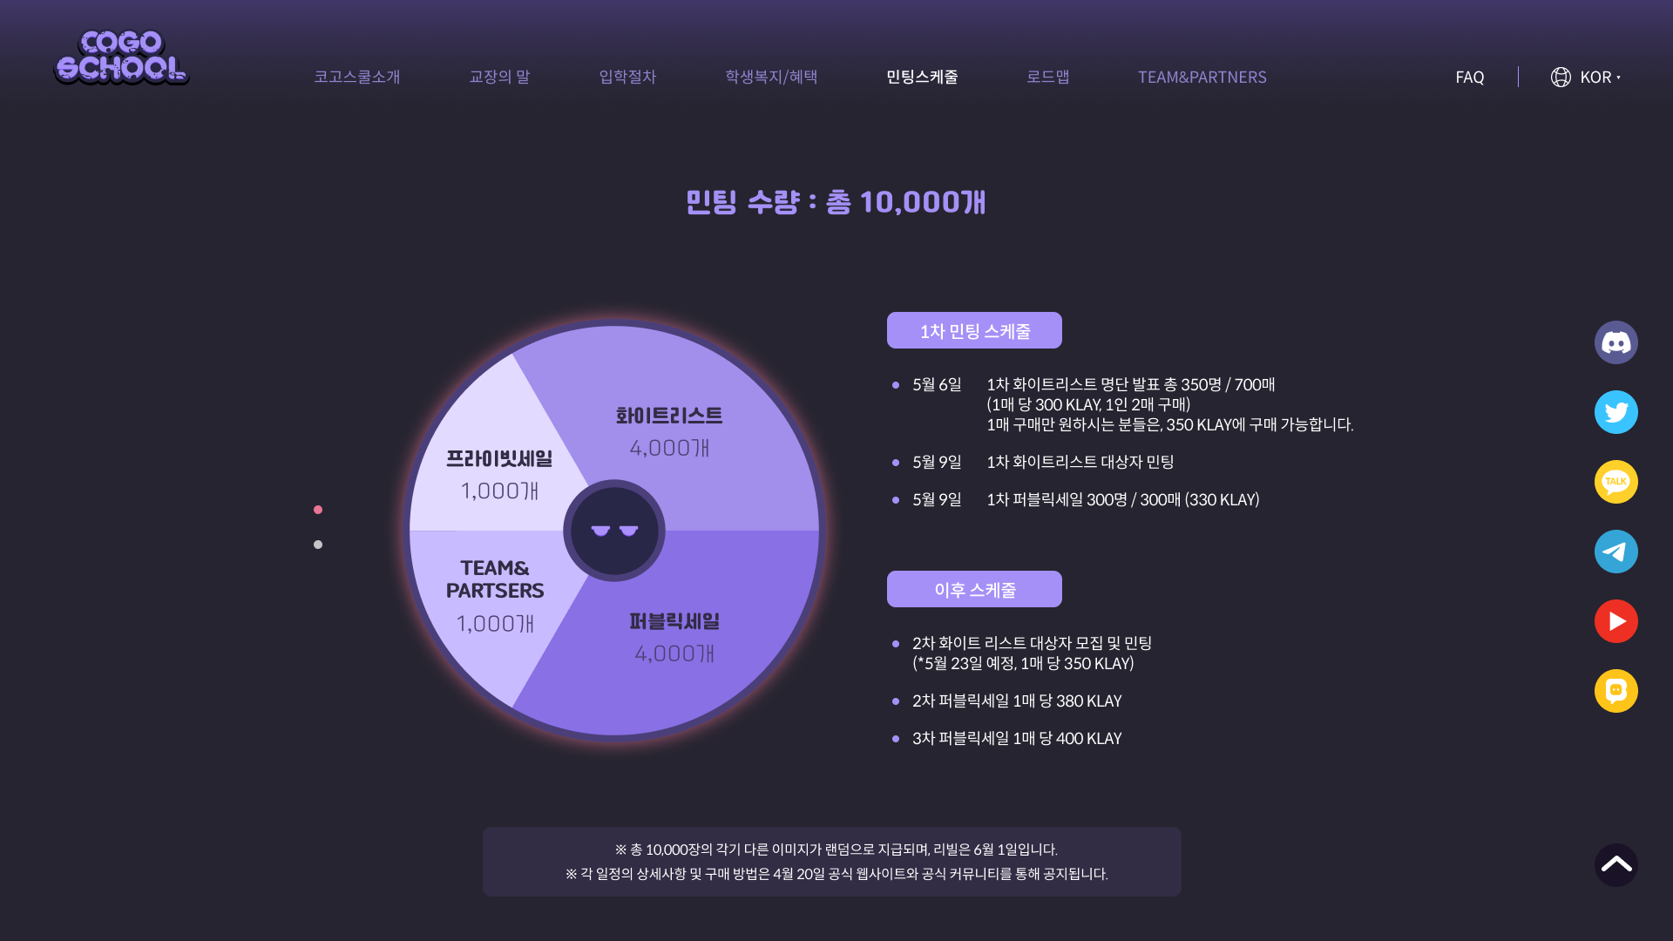
Cogoschool NFT Minting schedule
Total : 10,000 COGO
1st Miniting schedule May 6th, 1st Whitelist announcement total of 350 people / 700 pieces
300KLAY a piece, 2 pieces per person 350KLAY for a single piece purchase
May 9th 1st Whielist Minting May 9th, 1st Public Sale 300+ (In case Whitelist do not participate in minting, quantity to be added)
Future Schedule
2nd White list recruitment and minting (scheduled on May 23rd, 350 KLAY per piece) 2nd Public Sale, 380 KLAY per piece 3rd Public Sale, 400 KLAY per piece Total 10 thousand pieces to be given randomly and scheduled to be revealed on June 1st. Schedule details and purchase method can be checked on the official website and official community on April 20th.
Different image random. Reveal on June 1st.
Details of each schedule will be announced separately through the official community.

Slide 12
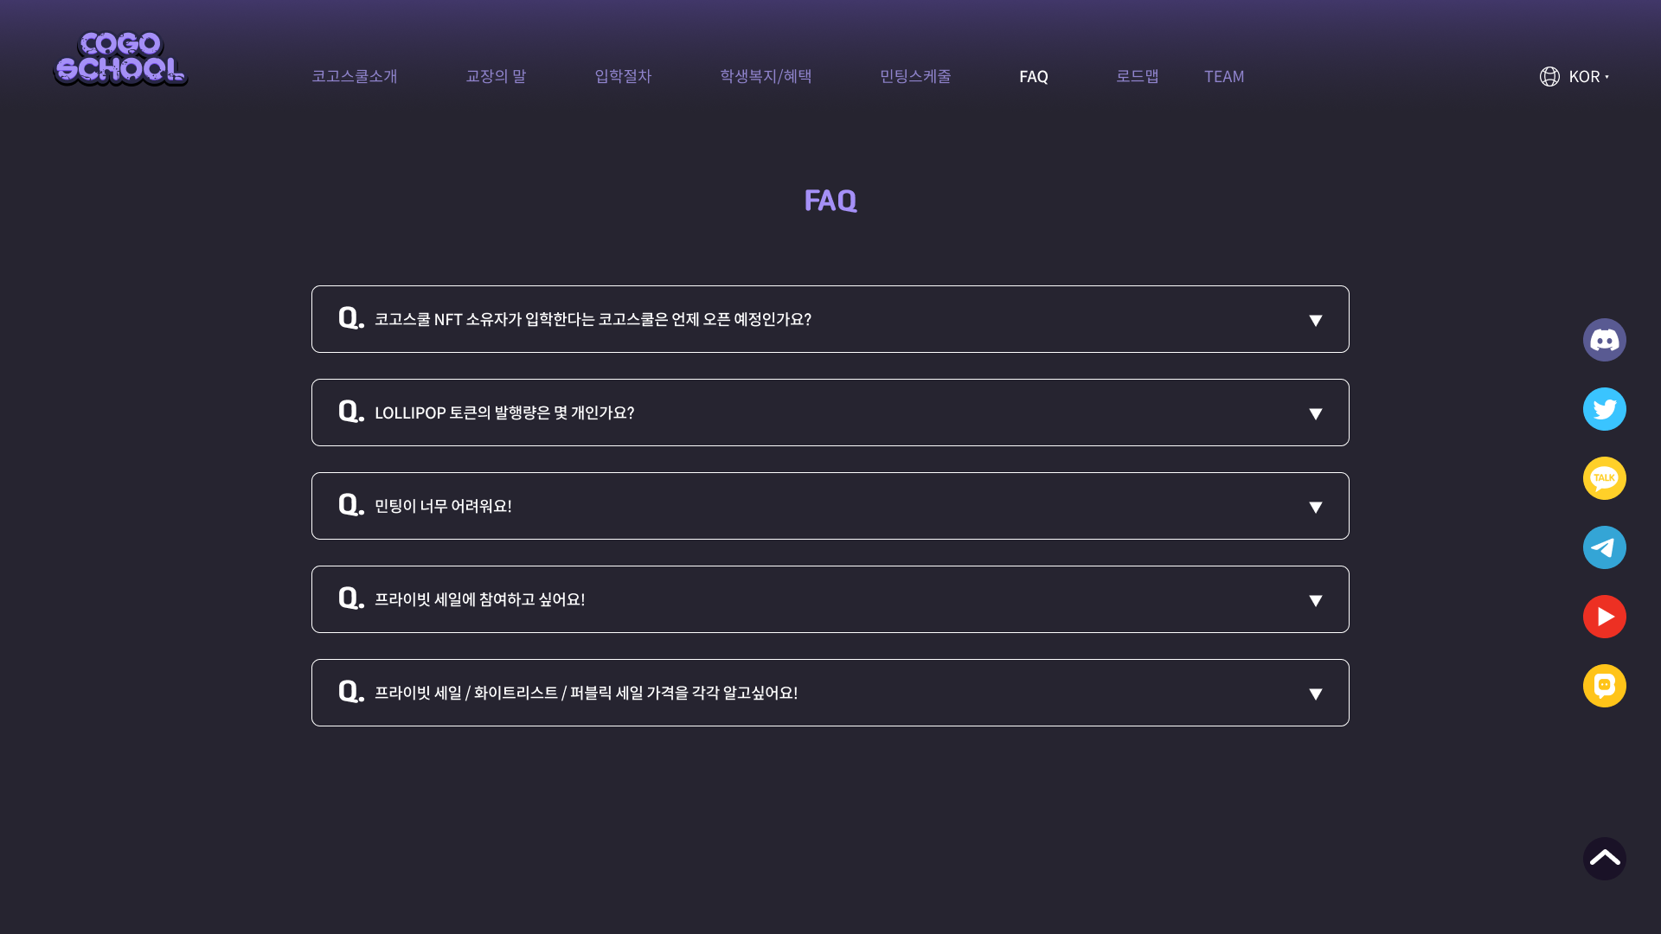
1)What’s the opening schedule for Cogoschool for Cogoschool NFT holders? It is scheduled to be open around the end of May, beginning of June. Please refer to the roadmap.
2) What’s the total supply of LOLLIPOP token? How many GSTs are to be swapped with LOLLIPOP?
Total supply of the token is 10 billion, and it to be used for the expansion of ecosystem.
3) Minting is too difficult!
VIDEO GUIDE NORMAL GUIDE
4) I would like to take part in the private sale!
ASK
5) What’s the price for Private Sale/ Whitlelist / Public Sale?
Private Sale : 350KLAY (limited to 1,000, max purchase pieces per person is 10) 1st Whitelist : 300KLAY (max 2pcs purchase/person) 1st Public Sale: 330KLAY (max 4pcs purchase/person) 2nd Whitelist : 350KLAY (max 2pcs purchase/person) 2nd Public Sale : 380KLAY (max 4pcs purchase/person) 3rd Public Sale : 400KLAY

Slide 13
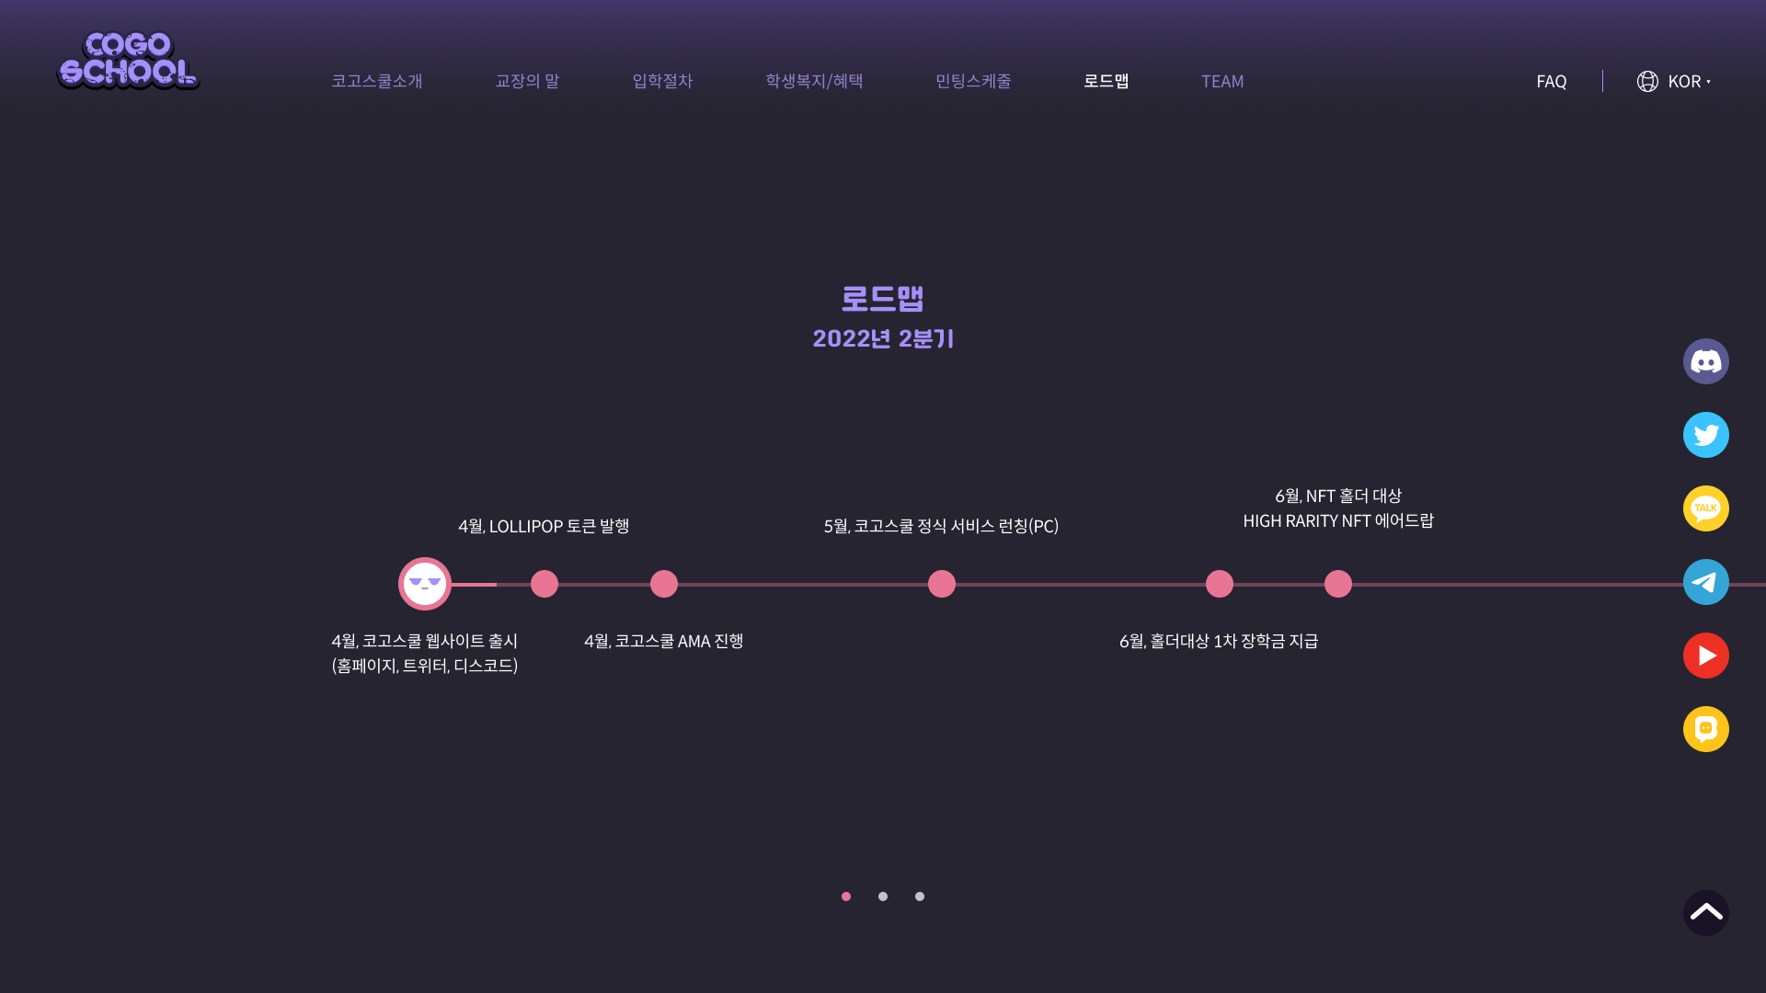
ROADMAP
2022. 2Q
APR. LOLLIPOP Token Issuance
APR. Website launch + Community
APR. CogoSchool AMA
MAY. Official service launch (PC)
JUN. 1st scholarship for holders
JUN. Rare NFT airdrops for NFT holders

Slide 14
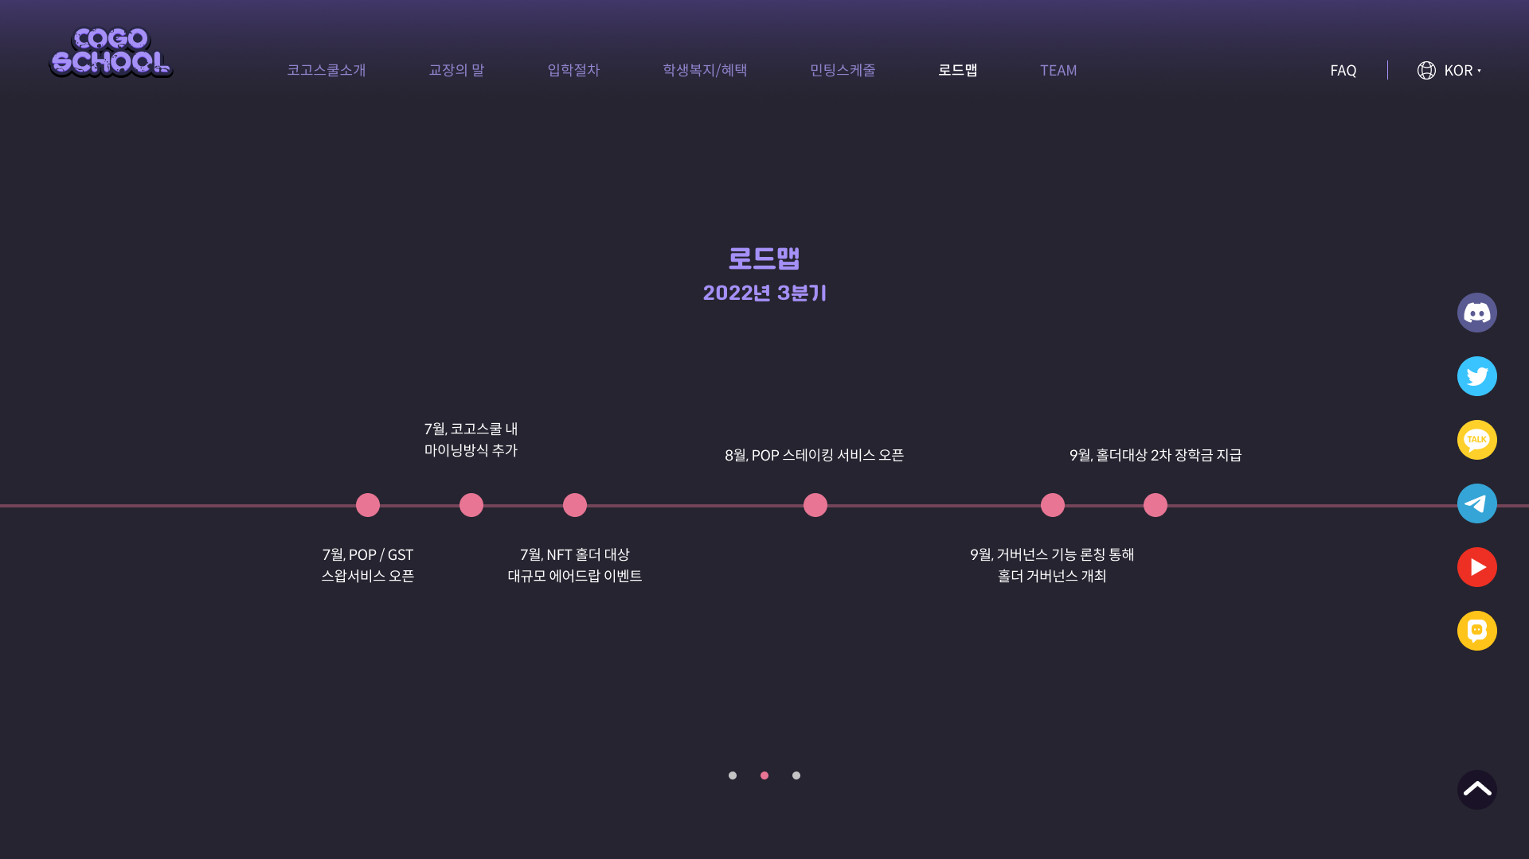
ROADMAP
2022. 3Q
JUL. Adding an in-service mining method
JUL. POP/GST Swap service installed
JUL. AirDrop Events
AUG. Staking service
SEP. Governance Functions
SEP. Second scholarship payment

Slide 15
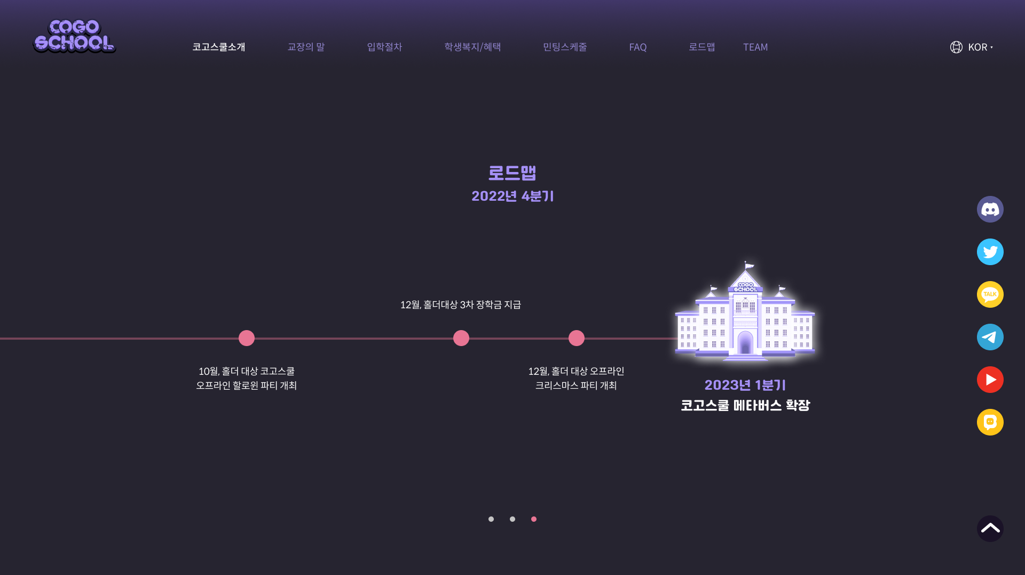
ROADMAP 2022 4Q
OCT. Holders' Halloween Party DEC. Third scholarship for holder DEC. Holder's Christmas party 2023.1Q Metabus Extensions

